Slide 1
Strings in C

Slide 2
Strings
What is string?
A string is a collection or group of characters enclosed in double quotes.
It is also known as an array of characters.
Example: “Hello”, “Belagavi”
Strings end with a null character (‘\0’)

Slide 3
String Taxonomy or Types of Strings
There are two types of strings:
1. Fixed-length string: is a type of string where length of string is fixed, length of the string cannot be changed, once defined. For instance, if you have a large string and you have reserved smaller space then larger half of string will not be stored. In contrast, if you have a small string and you have reserved larger space then limited memory is wasted.
2. Variable length string: is a type of string whose length is unknown as the name suggests. Storage container contracts and expands according to requirement of string length. But there has to be way to indicate the finish signal to compiler and for that purpose we have two general approaches and they are as follows:

Slide 4
a. Length controlled string: length information of string is stored as part of string. This information is stored as first byte and this is used as a counter.
b. Delimited variable length string: is a type of string wherein a delimiter (‘\0’) is used at end the string.

Slide 5
Declaring a String
Syntax of Declaring a string:
Example:
10 memory blocks are allocated, each block of one byte size, therefore, total size is 10 bytes , from the above declaration, as shown below,
char string_name[size];
char s[10];
S
S[0] | S[1] | S[2] | S[3] | S[4] | S[5] | S[6] | S[7] | S[8] | S[9]
1000 | 1001 | 1002 | 1003 | 1004 | 1005 | 1006 | 1007 | 1008 | 1009

Slide 6
Initializing a String
Initializing a String
Compile time initialization
Run time initialization
char s[6]={ ‘H’, ’E, ’L’, ’L’, ’O’, ’\0’ };
// Character constant, note in this we need to explicitly specify null character(‘\0’)
2. char s[6]=“HELLO”;
// String initialization
3. char s[ ]=“HELLO”; // Without size
1. Using scanf()
char s[6];
scanf(“%s”, s);
2. Using gets()
char s[6];
gets(s)
H | E | L | L | O | \0
S[0] | S[1] | S[2] | S[3] | S[4] | S[5]

Slide 7
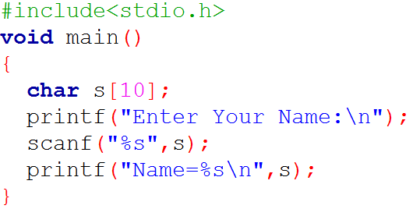
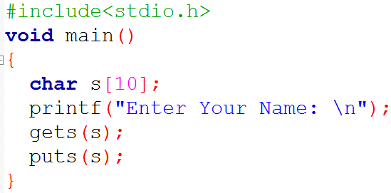
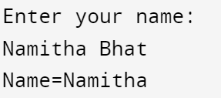
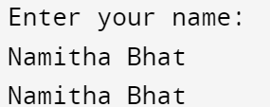
A Simple Program to Scan and Print a string
Both programs help us to scan and print a string, the only difference is, in first program scanf() is used and second gets() is used, however both are input functions which help us to scan a string.
scanf(): reads input until it encounters whitespace or newline. Once it encounters any of the two it stops and ends the string there itself with the delimiter.
gets(): reads a string until it encounters newline, once it encounters newline it ends the string there itself with the delimiter.

Slide 8
String Handling Functions/String Manipulation Functions
Strings have a very rich built in functions, for processing the string, which are defined in the header file <string.h>, hence if we want to use any of the string built in functions we need to include the header file in our program. Below are few important and basic string handling functions,
Functions | Description
strlen(s) | Find the length of the given string
strrev(s) | Reverses the given string
strcpy(s1,s2) | Copies one string to another string
strcmp(s1,s2) | Compares two strings for equality
strcat(s1,s2) | Concatenates or Joins two strings
strlwr(s) | Converts the given string to lower case string
strupr(s) | Converts the given string to uppercase string

Slide 9
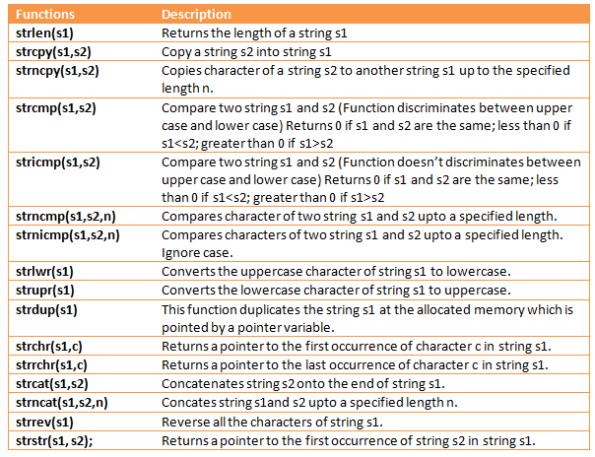

Slide 10
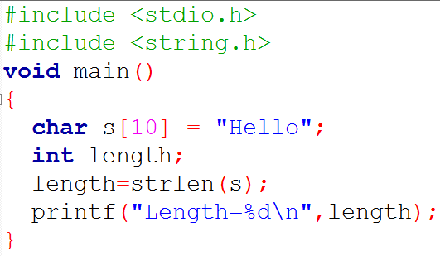
String Handling Functions
strlen():- it is used to find the length of the string.
-it returns an integer value.
Syntax: Example:
length=strlen(string);
char S[10]=“Hello”;
int length;
length = strlen(S);
Output:
Length=5

Slide 11
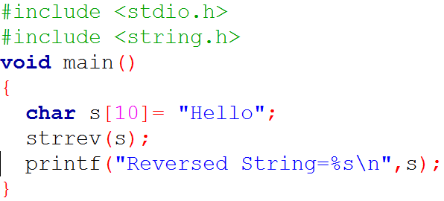
String Handling Functions
strrev():- it is used to reverse the given string.
-it returns a string.
Syntax: Example:
strrev(string);
char S[10]=“Hello”;
strrev(S);
Output:
Reversed String=olleH

Slide 12
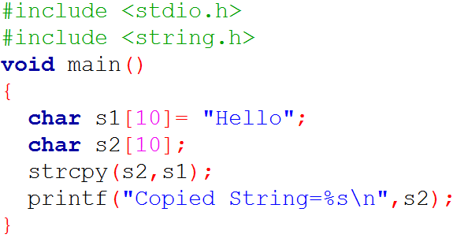
String Handling Functions
strcpy():- it is used to copy one string to another string.
-it returns a string.
Syntax: Example:
strcpy(destination_str, source_str);
char S1[10]=“Hello”;
char S2[10];
strcpy(S2,S1);
Output:
Copied String=Hello

Slide 13
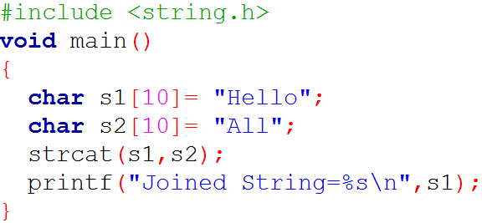
String Handling Functions
strcat():- it is used to join or concatenate two strings.
-it returns concatenated/joined string.
Syntax: Example:
strcat(string1, string2);
char S1[10]=“Hello”;
char S2[10]=“All”;
strcat(S1,S2);
Output:
Joined String=HelloAll

Slide 14
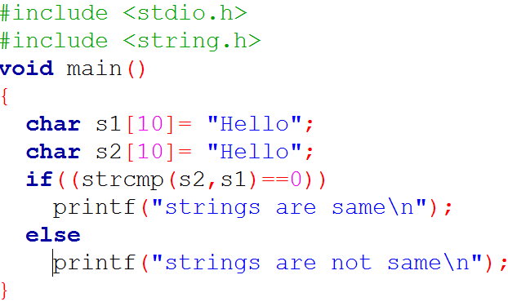
String Handling Functions
strcmp(): -it is used to compare two strings for equality.
-it returns zero if both strings are same.
Syntax: Example:
strcmp(string1, string2);
char S1[10]=“Hello”;
char S2[10]=“Hello”;
strcmp(S1,S2);
Output:
Strings are same

Slide 15
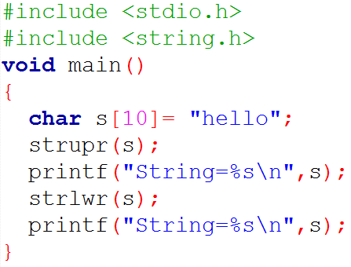
String Handling Functions
strlwr(): -it is used to change case of string to lower case.
strupr(): -it is used to change case of string to upper case.
Syntax: Example:
strlwr(string);
strupr(string);
char S[10]=“hello”;
strupr(S);
strlwr(S);
Output:
String=HELLO
String=hello

Slide 16
Programs on Strings

Slide 17
Program for finding Length of a given string
Consider a string S char S[10]=“HELLO”
H | E | L | L | O | \0
S[0] | S[1] | S[2] | S[3] | S[4] | S[5]
Let Initially COUNT=0
YES
Its ‘H’ Not Null character
Is S[0]!=‘\0’ ?
So, COUNT=1
YES
Its ‘E’ Not Null character
Is S[1]!=‘\0’ ?
So, COUNT=2
Is S[2]!=‘\0’ ?
YES
Its ‘L’ Not Null character
So, COUNT=3
Is S[3]!=‘\0’ ?
YES
Its ‘L’ Not Null character
So, COUNT=4
Is S[4]!=‘\0’ ?
YES
Its ‘0’ Not Null character
So, COUNT=5
Is S[5]!=‘\0’ ?
NO
Its ‘\0’ Null character
Therefore in general,
for(i=0;s[i]!=‘\0’;i++)
count=count+1

Slide 18
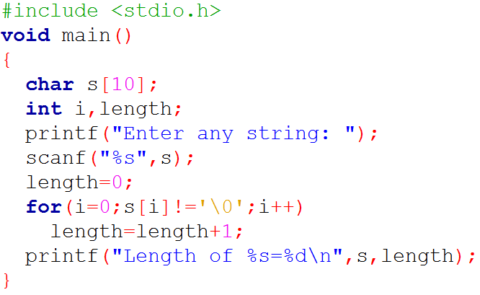
Write a C program to read a string and find the length of the string without using built-in function
Program:

Slide 19
Program to copy one string to another string
Consider two strings string S1 and string S2, char S1[10]=“HELLO”
S2[0] = S1[0]
H | E | L | L | O | \0
S1[0] | S1[1] | S1[2] | S1[3] | S1[4] | S1[5]
S2[1] = S1[1]
S2[2] = S1[2]
S2[0] | S2[1] | S2[2] | S2[3] | S2[4] | S2[5]
S2[3] = S1[3]
H
E
L
L
O
S2[4] = S1[4]
Therefore in general,
for( i=0; S1[i]!=‘\0’ ; i++)
S2[ i ] = S1[ i ]
S2[ i ]=‘\0’

Slide 20
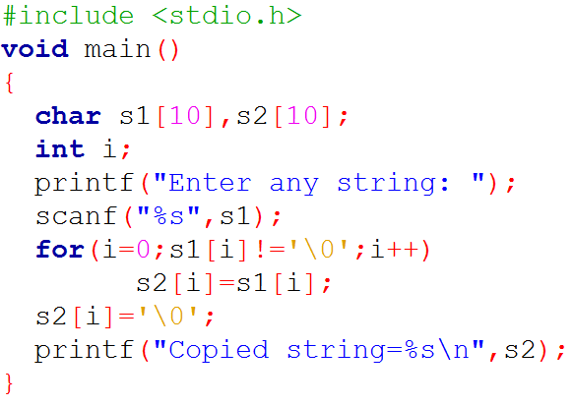

Write a C program to read a string s1 and copy its content to another string s2 without using built-in function
Program:
Output:

Slide 21
Program for concatenating two strings:
Consider two strings string S1 and string S2
char S1[10]=“HELLO” and char s2[10]=“ALL”
Length of S1 ?
To join to its end…!!!!
H | E | L | L | O | \0
S1[0] | S1[1] | S1[2] | S1[3] | S1[4] | S1[5] | S1[6] | S1[7] | S1[8]
A
L
L
A | L | L | \0
S2[0] | S2[1] | S2[2] | S2[3] | S2[4] | S2[5]
Therefore in general,
for(i=0;s[i]!=‘\0’;i++)
count=count+1
for( i=0; S2[i]!=‘\0’ ; i++,count++)
S1[ count ] = S2[ i ]
S1[ count ]= ‘\0’
S1[5] = S2[0]
S1[6] = S2[1]
S1[7] = S2[2]

Slide 22
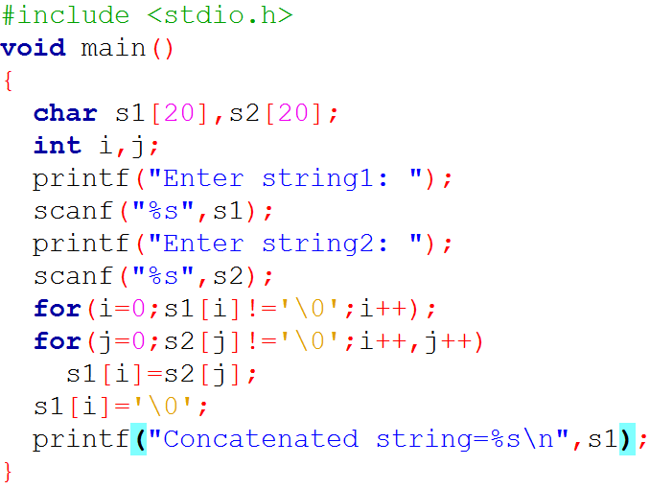
Write a C program to read two strings s1 and s2 and then concatenate both strings without using built-in function
Program:

Slide 23
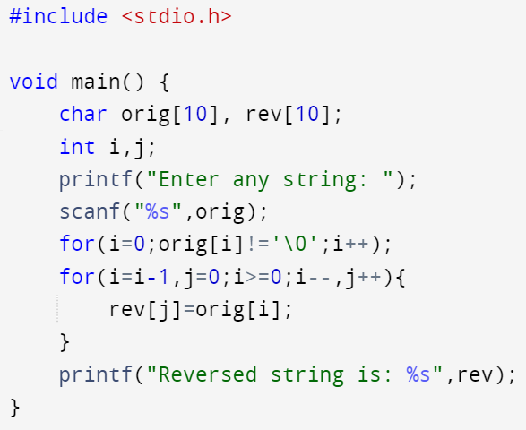

Write a C program to read a string s and then reverse it without using built-in function
Program:
Output:

Slide 24
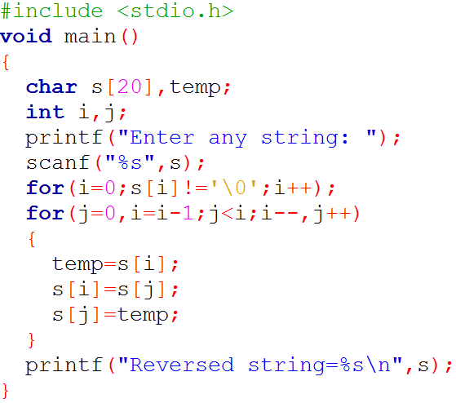

Write a C program to read a string s and then reverse it without using built-in function
Program:
Output:

Slide 25
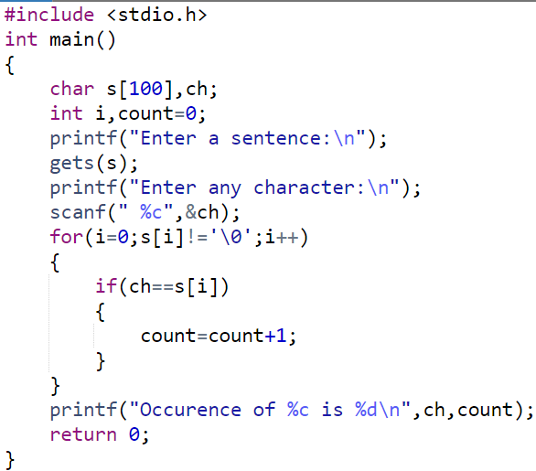
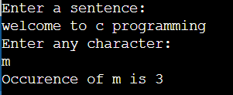
Write a program to read a sentence and count the frequency of the given character in the sentence.

Slide 26
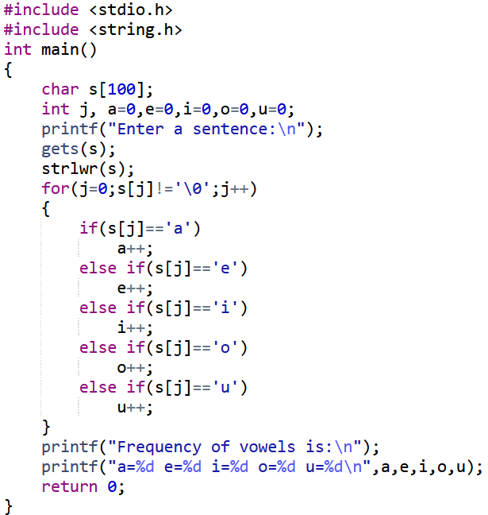
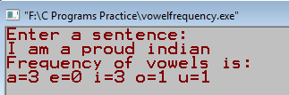
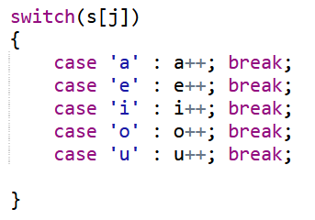
Write a program to read a sentence and count the frequency of each vowel in it.
OR

Slide 27
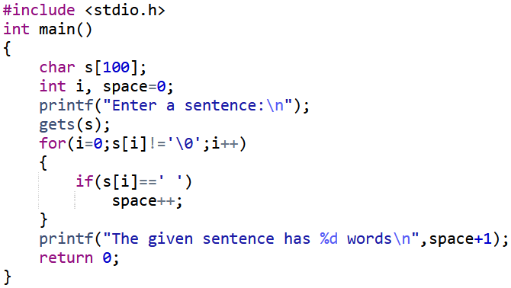

Write a program to read a sentence and count the number of words in it.

Slide 28
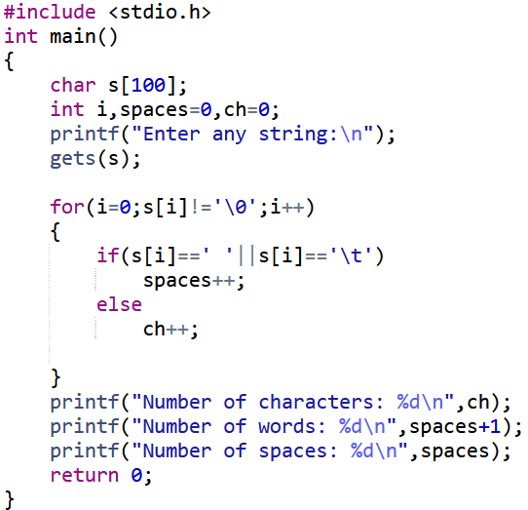
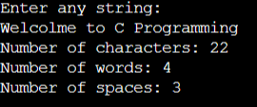
Write a program to read a sentence and count the number of characters, words, and spaces in it.

Slide 29
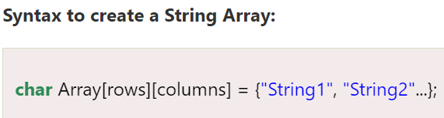
Arrays of Strings
An array of strings in C is a two-dimensional array of character types. Each String is terminated with a null character (\0). It is an application of a 2d array.
When we assign the number of rows and columns, we need to consider the Null Character to the length.

Slide 30
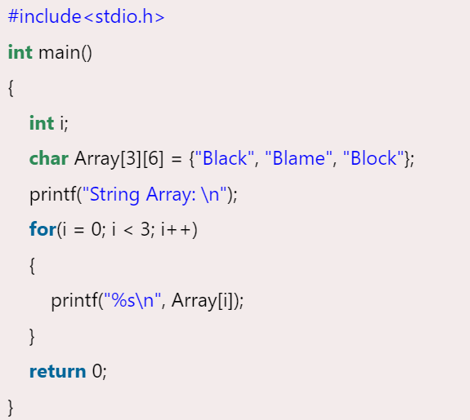
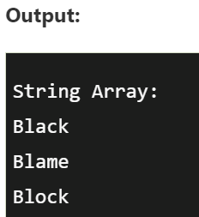

Slide 31
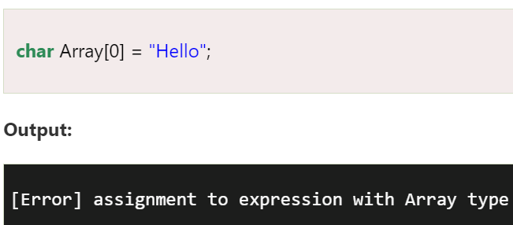
Arrays of Strings
char Array[3][6] = {"Black", "Blame", "Black"} -> {{'B', 'l', 'a', 'c', 'k', '\0'}, {'B', 'l', 'a', 'm', 'e', '\0'}, {'B', 'l', 'a', 'c', 'k', '\0'}}
We cannot directly manipulate the Strings in the Array as a String is an immutable data type. The compiler raises an error:

Slide 32
String and Character Functions
Reading Strings
The ways to read a string
char str[100];
Using scanf() function
The syntax is
scanf(“%s”, str);
Unlike integer, float and char, %s format does not require the & before the variable str.
Null character is appended automatically at the end of the string
The drawback with the scanf() function is that it terminates as soon as it finds a blank space
Using gets() function
The syntax is
gets(str);
It overcomes the drawbacks of the scanf() function

Slide 33
It takes the starting address of the string which will hold the input
The string will then be automatically terminated with a null character
Using getchar(), getch() or getche function
char ch;
The syntax is
getchar(ch);
It reads a single character.
It can be called repeatedly to read a sequence of single characters (until a terminating character is entered)
In this method, null character must be appended manually at the end of the sequence

Slide 34
Writing Strings
Ways to display/write a string on the screen
Using printf() function
The syntax is
printf(“%s”, str);
Using puts() function
The syntax is
puts(str);
It terminates the line with a newline character (‘\n’) which was not done by printf() function

Slide 35
Pointers

Slide 36
Introduction
A pointer is a derived type in C that contains memory address as its value.
Pointers can be used to return multiple values from a function via function arguments (output parameters).
Pointers allow C to support dynamic memory management.
Use of pointers increases the execution speed and thus reduces the program execution time.

Slide 37
Understanding Pointers
0
Computer’s memory is a sequential collection of storage location.
Each location, commonly known as a byte, is identified by an address associated with it.
These addresses are numbered consecutively, starting from zero.
The last address depends on the memory size.
A computer system having 64K memory has its last address as 65535.
1
2
3
4
5
.
.
.
.
65535

Slide 38
int quantity = 250;
A variable that can hold address of another variable is called a pointer variable.
quantity
variable
250
value
5000
address

Slide 39
int quantity = 250;
int *p = &quantity;
Since the value of the variable p is the address of the variable quantity, we may access the value of quantity by using the variable p, and therefore we say that the variable p points to the variable quantity. Thus p is the name of the pointer.
variable
value
address
quantity
250
5000
p
5000
5012

Slide 40
Accessing the Address of a Variable
We can access the address of a variable with the & operator in C.
We have already used & operator in scanf function.
The operator & immediately preceding the variable returns the address of the variable associated with it.
p = &quantity; //assigns the address 5000 to p.
The & operator can be used only with a simple variable or an array element.

Slide 41
main()
{
int a;
float p, q;
char choice;
a = 15;
p = 10.25f;
q = 5.46f;
choice = 'Y';
printf("%d is stored at address %u\n", a, &a);
printf("%f is stored at address %u\n", p, &p);
printf("%f is stored at address %u\n", q, &q);
printf("%c is stored at address %u\n", choice, &choice);
}
Output:
15 is stored at address 6356748
10.250000 is stored at address 6356744
5.460000 is stored at address 6356740
Y is stored at address 6356739

Slide 42
Declaring Pointer Variables
datatype *ptr_name;
The asterix (*) tells that the variable ptr_name is a pointer variable.
ptr_name needs a memory location.
ptr_name points to a variable of type data_type.
int *p; // declares the variable p as a pointer variable that can point to an // integer data type.
float *q; // declares the variable q as a pointer variable that can point to // an float data type.
Since the memory locations corresponding to p and q have not been assigned any values, these contain garbage value and therefore point to unknown locations.
Example: int *p;
p
?
?
contains garbage
points to unknown location

Slide 43
Initialization of Pointer Variable
The process of assigning the address of a variable to a pointer variable is known as initialization.
Uninitialized pointers will have unknown values.
It is important to initialize pointer variables before they are used in the program.
int quantity;
int *p;
p = &quantity;
int *p = &quantity;

Slide 44
Initialization of Pointer Variable
We must ensure that the pointer variables always point to the corresponding type of data.
float a, b;
int sum, *p;
p = &a; // Wrong
It is possible to declare combine declaration of simple variable, declaration and initialization pointer variable in one statement.
int a, *p = &a;
Declares a as an integer variable and p as a pointer variable and then initializes p to address of a.
We can also define a pointer variable with an initial value of NULL or zero.
int *p = NULL; // same as int *p = 0;

Slide 45
Accessing a Variable Through its Pointer
To access value of a variable using the pointer, we use the asterisk (*) operator, also known as the indirection operator or dereferencing operator.
int quantity, *p, n;
quantity = 250;
p = &quantity;
n = *p; // equivalent to n = *&quantity; which in turn // is equivalent to n = quantity;
Here *p returns the value of the variable quantity.

Slide 46
main()
{
int a, b;
int *p;
a = 15;
p = &a;
b = *p;
printf("Value of a is %d and address is %u\n", a, &a);
printf("Value of a is %d and address is %u\n", *&a, &a);
printf("Value of a is %d and address is %u\n", *p, p);
printf("%d is the address pointed to by %u\n", p, &p);
printf("Value of b is %d and address is %u\n", b, &b);
*p = 25;
printf("Now the value of a is %d", a);
}
Value of a is 15 and address is 6356748
Value of a is 15 and address is 6356748
Value of a is 15 and address is 6356748
6356748 is the address pointed to by 6356740
Value of b is 15 and address is 6356744
Now the value of a is 25

Slide 47
Stage
Values stored in locations and their addresses
a
b
p
Declaration
6356748
6356744
6356740
a
b
p
a = 10
10
6356748
6356744
6356740
a
b
p
p = &a
10
6356748
6356748
6356744
6356740
a
b
p
b = *p
10
10
6356748
6356748
6356744
6356740
a
b
p
b = *p
10
10
6356748
6356748
6356744
6356740

Slide 48
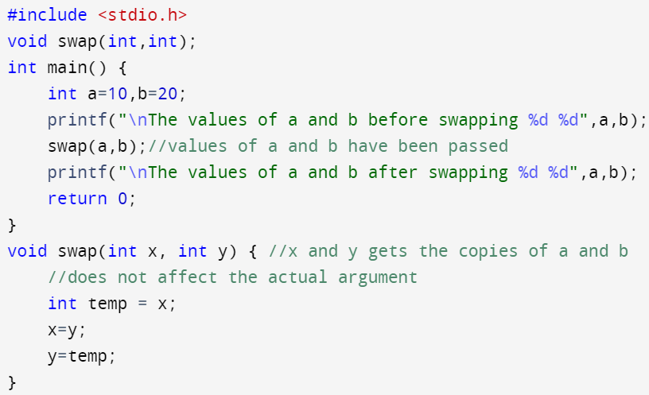

Call by Value/ Pass by Value
OUTPUT

Slide 49
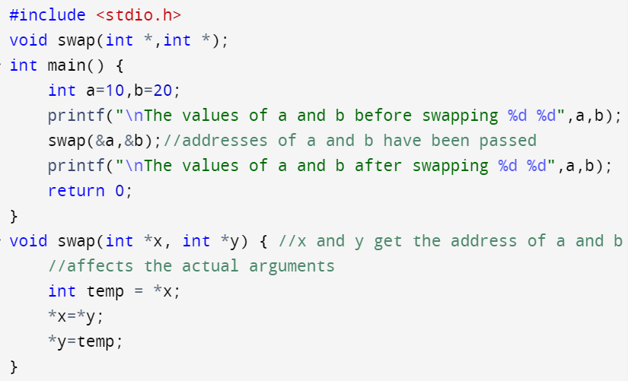

Call by Reference/ Pass by Reference
OUTPUT

